Slide 1
Custom Middleware|NPM Libs
By : Parveen & Abhishek

Slide 2
Agenda
Custom Middleware
Promises
Async/await
Child-process
Buffer/Stream
Request

Slide 3
Middleware : Overview
Middleware functions are functions that have access to the request object (req), the response object (res), and the next function in the application’s request-response cycle. The next function is a function in the Express router which, when invoked, executes the middleware succeeding the current middleware.
Middleware functions can perform the following tasks:
Execute any code.
Make changes to the request and the response objects.
End the request-response cycle.
Call the next middleware in the stack.

Slide 4
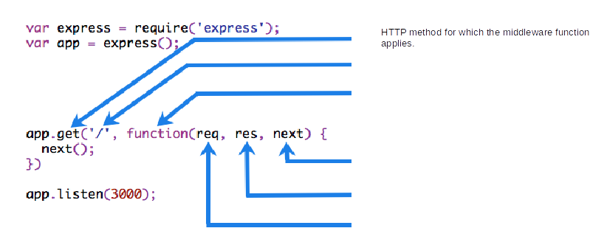
Understanding Middleware
If the current middleware function does not end the request-response cycle, it must call next() to pass control to the next middleware function. Otherwise, the request will be left hanging.
The following figure shows the elements of a middleware function call:
HTTP method for which the middleware function applies.
Path (route) for which the middleware function applies.
The middleware function.
Callback argument to the middleware function, called "next" by convention.
HTTP response argument to the middleware function, called "res" by convention.
HTTP request argument to the middleware function, called "req" by convention.

Slide 5
Middleware
//server.js //logging middleware function middleware(req, res, next) { console.info('inside middleware'); //do something with req, call next once done next(); } //how to use it app.use(middleware); //add static server app.use('/static', Express.static('views'));

Slide 6
Custom Middleware function
Example of checking the request method and if we the method is “GET” we returns the response with GET method not allowed on this server.
module.exports = function(req,res,next) {
if(req.method === 'GET') {
res.end('GET method not supported');
} else {
next();
}
};

Slide 7
Middleware function requestChecker
Every time the app receives a request, it checks the request method if it is GET if yes the return response from middleware itself.
The order of middleware loading is important: middleware functions that are loaded first are also executed first.
If “requestChecker” is loaded after the route to the root path, the request never reaches it and the app will not able to check the method of “req”, because the route handler of the root path terminates the request-response cycle.
The middleware function requestChecker simply checks the method of request, then passes on the request to the next middleware function in the stack by calling the next() function.
Notes:
Write a middleware for checking the session or any token in request to validate that request.

Slide 8
Middleware functions request time.
Next, we’ll create a middleware function called “requestTime” and add it as a property called requestTime to the request object.
const express = require('express')
const app = express()
const requestTime = (req, res, next) => {
req.requestTime = Date.now();
next();
}
app.use(requestTime);
app.get('/', (req, res) => {
var responseText = 'Hello World!<br>'
responseText += '<small>Requested at: ' + req.requestTime + '</small>'
res.send(responseText);
});
app.listen(3000);

Slide 9
Types of Express Middleware
Application level middleware app.use
Router level middleware router.use
Built-in middleware express.static,express.json,express.urlencoded
Error handling middleware app.use(err,req,res,next)
Third party middleware bodyparser,cookieparser

Slide 10
Promises
What is a Promise?
According to the official website:
A Promise is a proxy for a value not necessarily known when the promise is created. It allows you to associate handlers to an asynchronous action's eventual success value or failure reason. This lets asynchronous methods return values like synchronous methods: instead of the final value, the asynchronous method returns a promise for the value at some point in the future.
In simple words “A promise is a word taken for some action, the other party who gave the promise might fulfill it or deny it”. In the case of fulfilling, the promise gets resolved, and in another case, it gets rejected.
Promises are kind of design patterns to remove the usage of unintuitive callbacks.

Slide 11
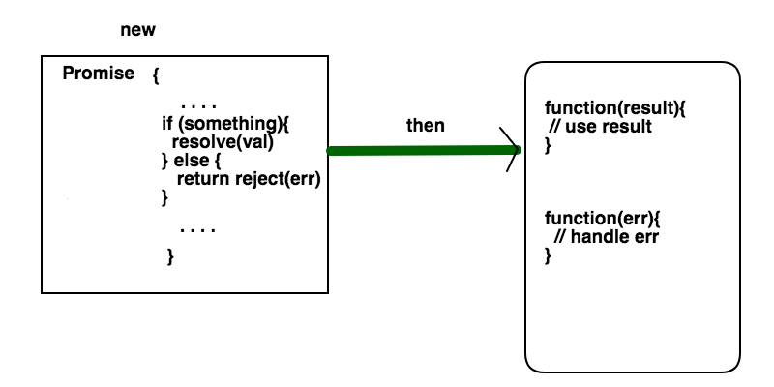
Promises

Slide 12
Promises
A promise can be created in our JavaScript code. Or else it can be returned from an external node package
Any promise that performs async operations should call any one of the two methods resolve or reject. The code logic should take care of when and where to call these functions. If the operation is successful, pass that data to the code that uses that promise, otherwise pass error
The code which uses a promise should call then function on that promise. It takes two anonymous functions as parameters. The first function executes if the promise is resolved and the second function executes if promise is rejected
Notes:
What happens if you try to access the value from promise before it is resolved or rejected. Then promise will be in the pending state?

Slide 13
Promises
var promise = new Promise((resolve, reject)=>{
...
});
Notes:
What happens if you try to access the value from promise before it is resolved or rejected. Then promise will be in the pending state?

Slide 14
Promises
Promise.all[]
We can make a sequence of promises for doing things in a particular order. We can use Promise.all function which takes a list of promises in the given order and returns another promise which we can use a then method to conclude the logic.
Note: Promise.all fails if any one of the Promise got rejected. It is an and operation between promise fulfillments
Notes:
What happens if you try to access the value from promise before it is resolved or rejected. Then promise will be in the pending state?

Slide 15
Async/Await
What is Async/Await?
The newest way to write asynchronous code in JavaScript.
It is non blocking (just like promises and callbacks).
Async/Await was created to simplify the process of working with and writing chained promises.
Async functions return a Promise. If the function throws an error, the Promise will be rejected. If the function returns a value, the Promise will be resolved.

Slide 16
Async/Await
Syntax
Writing an async function is quite simple. You just need to add the async keyword prior to function: Normal Function
function add(x,y){
return x + y;
}
// Async Function
async function add(x,y){
return x + y;
}
Await
Async functions can make use of the await expression. This will pause the async function and wait for the Promise to resolve prior to moving on.

Slide 17
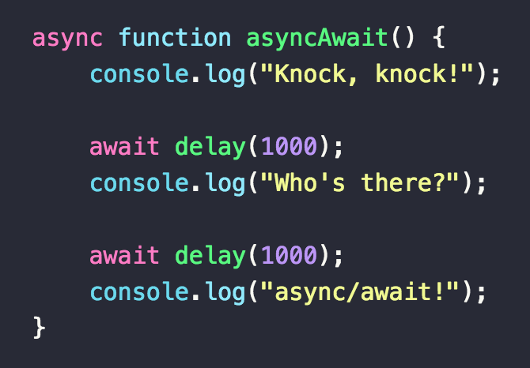
Async/Await

Slide 18
Child Process
Node.js runs in a single-thread mode, but it uses an event-driven paradigm to handle concurrency. It also facilitates creation of child processes to leverage parallel processing on multi-core CPU based systems.
Child processes always have three streams child.stdin, child.stdout, and child.stderr which may be shared with the stdio streams of the parent process.
Node provides child_process module which has the following three major ways to create a child process.
exec − child_process.exec method runs a command in a shell/console and buffers the output.
spawn − child_process.spawn launches a new process with a given command.
fork − The child_process.fork method is a special case of the spawn() to create child processes.

Slide 19
The exec() method
child_process.exec method runs a command in a shell and buffers the output. It has the following signature −
child_process.exec(command[, options], callback)
Parameters
command (String) The command to run, with space-separated arguments
options (Object) may comprise one or more of the following options −
cwd (String) Current working directory of the child process
env (Object) Environment key-value pairs
encoding (String) (Default: 'utf8')
shell (String) Shell to execute the command with (Default: '/bin/sh' on UNIX, 'cmd.exe' on Windows)
timeout (Number) (Default: 0)
maxBuffer (Number) (Default: 200*1024)
killSignal (String) (Default: 'SIGTERM')
uid (Number) Sets the user identity of the process.
gid (Number) Sets the group identity of the process.
callback The function gets three arguments error, stdout, and stderr which are called with the output when the process terminates.

Slide 20
The spawn() method
child_process.spawn(command[, args][, options])
Parameters
command (String) The command to run
args (Array) List of string arguments
options (Object) may comprise one or more of the following options −
cwd (String) Current working directory of the child process.
env (Object) Environment key-value pairs.
stdio (Array) String Child's stdio configuration.
customFds (Array) Deprecated File descriptors for the child to use for stdio.
detached (Boolean) The child will be a process group leader.
uid (Number) Sets the user identity of the process.
gid (Number) Sets the group identity of the process.
The spawn() method returns streams (stdout & stderr) and it should be used when the process returns a volume amount of data. spawn() starts receiving the response as soon as the process starts executing.

Slide 21
The spawn() method
The spawn function launches a command in a new process and we can use it to pass that command any arguments.

Slide 22
The fork() method
child_process.fork(modulePath[, args][, options])
The fork function is a variation of the spawn function for spawning node processes. The biggest difference between spawn and fork is that a communication channel is established to the child process when using fork, so we can use the send function on the forked process along with the global process object itself to exchange messages between the parent and forked processes. We do this through the EventEmitter module interface.

Slide 23
Buffer/Stream
Buffer
Buffer class provides instances to store raw data similar to an array of integers but corresponds to a raw memory allocation outside the V8 heap. Buffer instance is not resizable.

Slide 24
Buffer/Stream
Methods & Properties
Constructor / from / alloc / allocUnsafe / allocUnsafeSlow
.fill
.write
.isBuffer
.concat
.compare
.equals
.includes
.indexOf

Slide 25
Buffer/Stream
Methods & Properties
.lastIndexOf
.keys
.entries
.length
.slice
.toJSON
.toString

Slide 26
Buffer/Stream
Stream
Streams are objects that let you read data from a source or write data to a destination in continuous fashion. There are four types of streams:
Readable
Writable
Duplex
Transform

Slide 27
Buffer/Stream
Events
data
end
error
finish
Examples: https://www.tutorialspoint.com/nodejs/nodejs_streams.htm

Slide 28
Requests
Some popular modules to make HTTP requests:
HTTP
request
axios
superagent
got

Slide 29
Exercise
1.Create on custom middleware to validate the session of user if valid session allow to access request otherwise send back.
2. Create Example for Buffer, Streams and pipe.
3. Create API using Async/Await or Promises, fetch github profile and followers. (https://api.github.com/users/<username>)
4.Child Process execFile(); example .

Slide 30
Thank You
Any queries? Open to Q&A

